Slide 1
Joins
A JOIN clause is used to combine rows from two or more tables, based on a related column between them.
Let's look at a selection from the "Orders" table:
OrderID | CustomerID | OrderDate
10308 | 2 | 1996-09-18
10309 | 37 | 1996-09-19
10310 | 77 | 1996-09-20

Slide 2
Joins
CustomerID | CustomerName | ContactName | Country
1 | Alfreds Futterkiste | Maria Anders | Germany
2 | Ana Trujillo Emparedados y helados | Ana Trujillo | Mexico
3 | Antonio Moreno Taquería | Antonio Moreno | Mexico

Slide 3
Joins
Different Types of SQL JOINs
(INNER) JOIN: Returns records that have matching values in both tables
LEFT (OUTER) JOIN: Returns all records from the left table, and the matched records from the right table
RIGHT (OUTER) JOIN: Returns all records from the right table, and the matched records from the left table
FULL (OUTER) JOIN: Returns all records when there is a match in either left or right table

Slide 4
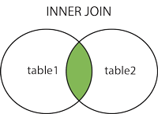
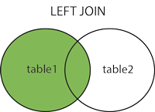
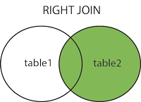
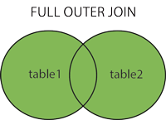
Joins

Slide 5
Joins
SQL INNER JOIN Keyword
The INNER JOIN keyword selects records that have matching values in both tables.
INNER JOIN Syntax
SELECT column_name(s)
FROM table1
INNER JOIN table2
ON table1.column_name = table2.column_name;

Slide 6
Joins
SQL LEFT JOIN Keyword
The LEFT JOIN keyword returns all records from the left table (table1), and the matching records from the right table (table2). The result is 0 records from the right side, if there is no match.

Slide 7
Joins
LEFT JOIN Syntax
SELECT column_name(s)
FROM table1
LEFT JOIN table2
ON table1.column_name = table2.column_name;

Slide 8
Joins
SQL RIGHT JOIN Keyword
The RIGHT JOIN keyword returns all records from the right table , and the matching records from the left table.
The result is 0 records from the left side, if there is no match.

Slide 9
Joins
RIGHT JOIN Syntax
SELECT column_name(s)
FROM table1
RIGHT JOIN table2
ON table1.column_name = table2.column_name;

Slide 10
Joins
SQL FULL OUTER JOIN Keyword
The FULL OUTER JOIN keyword returns all records when there is a match in left (table1) or right (table2) table records.
FULL OUTER JOIN and FULL JOIN are the same.
The FULL OUTER JOIN keyword returns all matching records from both tables whether the other table matches or not. So, if there are rows in "Customers" that do not have matches in "Orders", or if there are rows in "Orders" that do not have matches in "Customers", those rows will be listed as well.

Slide 11
Joins
FULL OUTER JOIN Syntax
SELECT column_name(s)
FROM table1
FULL OUTER JOIN table2
ON table1.column_name = table2.column_name
WHERE condition;

Slide 12
Joins
Select all records from the two tables where there is a match in both tables.
2. Select all the records from the Customers table plus all the matches
in the Orders table.
3. Select all customers, and any orders they might have
4. Select all employees, and any orders they might have placed.
5. Select all the records from the Customers table plus all the matches
in the Orders table.
6. Select all customers, and all orders

Slide 13
Joins

Slide 14
Joins

Slide 15
Joins

Slide 16
Joins

